Slide 1

Analysis of
Educational Inequality in Korea
Team 9
Notes:
Hello, everyone. This is team 9. Our team project topic is an analysis of educational inequality in Korea.

Slide 2
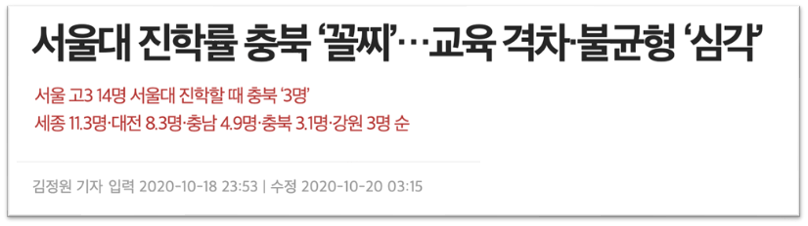


Project Objectives
Entrance rate of Seoul National University, Chungbuk is the ‘lowest’
Education inequality problem is ‘serious’
Does exist?
How exists?
Which fator matters?
Notes:
Many people and news has said that there is a serious educational inequality problem in Korea. A recent article says that there are huge differences among the entrance rates of Seoul National University in each city. Then, does this problem really exist, and is it statistically significant? [NEXT] Our project wants to find out whether educational inequality exists in Korea, and if does, how it exists, and which factor matters to the problem.

Slide 3
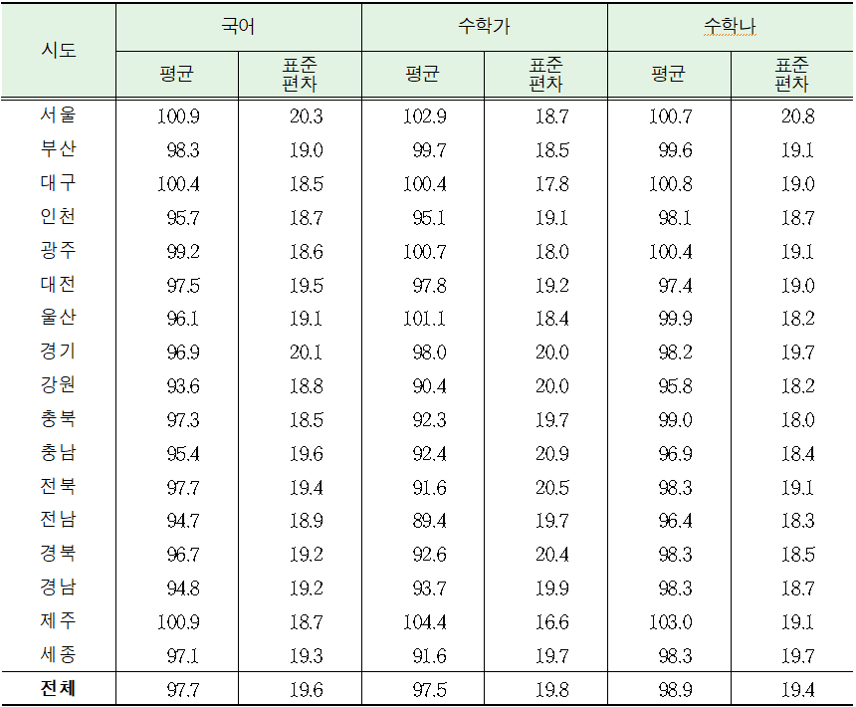

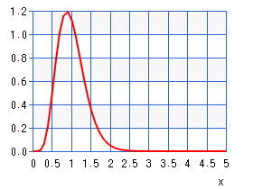
Does Educational Inequality Exist in Korea?
scores of college entrance exam(Su-neung) [1]
ANOVA 17 cities | 387,220 examinees
F16, 387203
f(x)
Distributions are not the same!
0.95
+ the number of examinees in each city [1]
1.64
x
[1] Korean Educational Statistics Service (KESS, 교육통계서비스), We used data from 2019.
Notes:
First, we tried to check the inequality. We collected scores of the 2019 college entrance exam, called 수능. Because math is split into math A and B, [NEXT] we decided to use Korean scores data only. The government doesn't provide each student's exam score, but only provides each city's average and standard deviation of the scores. We also collected the number of examinees in each city, so we were able to conduct [NEXT] ANOVA analysis. The results of ANOVA show that its F-value is 287. Using the F distribution graph, [NEXT] we found that the p-value of our result is far smaller than 0.05, so distributions of entrance exam scores in each city are not the same.

Slide 4
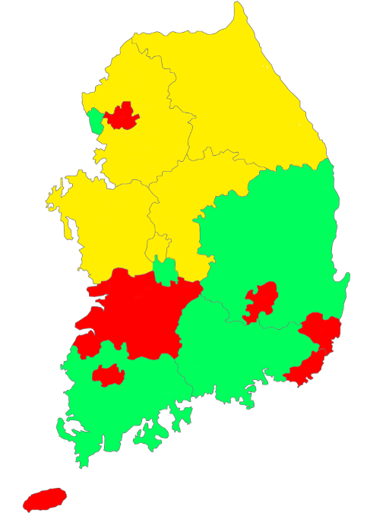
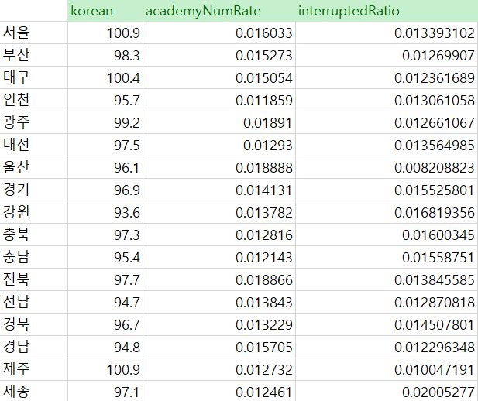
How does Educational Inequality Exist in Korea?
Clustering 17 cities | 3 features | k-mean
1
academy rate [1]
(educational opportunity)
Seoul, Busan, Daegu, Gwangju,
Ulsan, Jeonbuk, Jeju
academic interruption rate [1]
(educational progress)
3
Gyeonggi, Gangwon, Chungbuk, Chungnam, Sejong
entrance exam Korean score [2]
(academic achievement)
1
Incheon, Daejeon, Jeonnam, Gyeongbuk, Gyeongnam
Seoul and Metropolis Cities have a better educational environment!
...
[1] Korean Educational Statistics Service (KESS, 교육통계서비스), We used data from 2019.
[2] Korea Institute for Curriculum and Evaluation (KICE, 한국교육과정평가원), We used data from 2019.
Notes:
Then, how does educational inequality exist in Korea? We conducted a clustering method with 3 features: academy rate, academic interruption rate, and entrance exam Korean score. Academy rate means the number of academies divided by the number of students, and similar to academic interruption rate. These features each represent educational opportunity, progress, and academic achievement. [NEXT] Here is the results. Seoul, Busan, and Daegu are clustered in one group, Gyeonggi-do and Chungcheong-do are in another group, and finally, Daejeon and Gyeongsang-do are in the other group. You may see that Seoul and some Metropolis Cities, called 광역시, are in the same group, represented in red color, [NEXT] and they have the highest academy rate and exam score, but the lowest academic interruption rate. [NEXT] Thus, we concluded that Seoul and Metropolis Cities have a better educational environment than others.

Slide 5





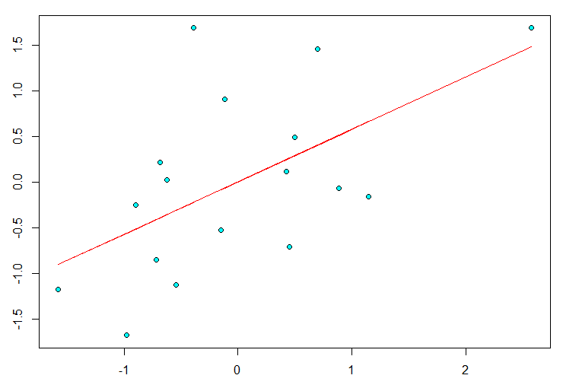
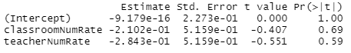
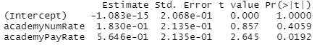
What Factors Influence Educational Inequality?
public education
private education
?
entrance exam
Korean score
classroom rate [1]
teacher rate [1]
academy rate [1]
academy pay rate [2]
Linear Regression
entrance exam
Korean score
(scaled)
Academy pay rate is important to exam score!
[1] Korean Educational Statistics Service (KESS, 교육통계서비스), We used data from 2019.
[2] KOrean Statistical Information Service (KOSIS, 국가통계포털), We used data from 2019.
academy pay rate (scaled)
Notes:
Now, our final question is what factors influence educational inequality? We collected four data that are related to educational environments; classroom rate, teacher rate, academy rate, and academy pay rate. Among them, [NEXT] which factors are correlated to entrance exam score? [NEXT] Multivariate linear regression analysis could answer that question. The result told us that the academy pay rate only got a p-value smaller than 0.05 and a meaningful correlation to exam score. [NEXT] Therefore, we found that the academy pay rate is important to get better exam scores.

Slide 6
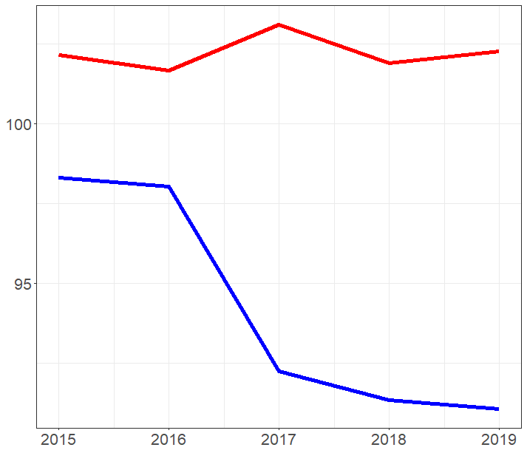
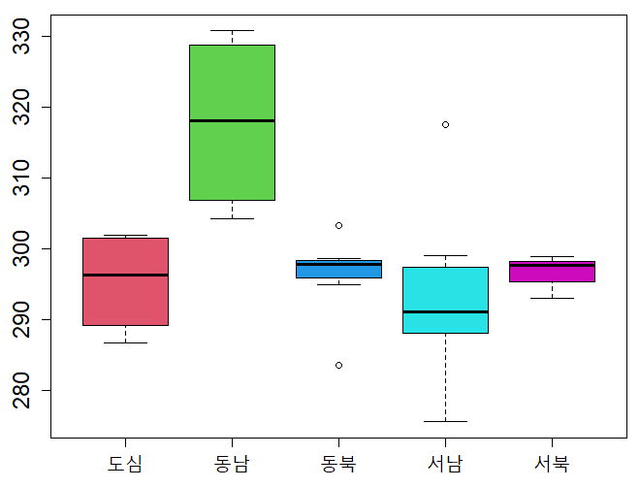
Additional Analyses
[1]
[2]
sum of entrance
exam scores
entrance exam
mathA score
highest 5
(Jeju, Seoul, Ulsan, Gwangju, Daeju)
lowest 5
(Jeonnam, Gangwon
Sejong, Jeonbuk, Chungbuk)
year
division of Seoul
Educational inequality gap increased.
Educational inequality also exists in Seoul.
[1] Korean Educational Statistics Service (KESS, 교육통계서비스), We used data from 2015 to 2019.
[2] OhmyNews, http://www.ohmynews.com/NWS_Web/View/at_pg_w.aspx?CNTN_CD=A0002142488
Notes:
Our team also conducted deeper additional analyses. We visualized the entrance exam scores from 2015 to 2019 with line graphs. The red line represents the average of the highest exam scores in 5 cities, and the blue line represents the 5 lowest ones. The gap between the two lines increased in 2019 compared to 2015, which means the educational inequality gap seems to increase. [NEXT] Moreover, inequality even exists inside Seoul. We divided Seoul into five subgroups according to its location, and the 동남 area including 강남 has shown the highest exam score through ANOVA analysis. The details will be described in the report.

Slide 7
Summary
ANOVA
Distributions of entrance exam scores are not the same in each city.
Clustering
Seoul and Metropolitan Cities have the best educational environment.
Linear Regression
As academy pay rate increases, exam score also tends to increase.
Notes:
In summary, our team first verified that distributions of entrance exam scores are not the same in each city by ANOVA analysis. Second, clustering showed Seoul and Metropolitan Cities have the best educational environment. Third, we also found as academy pay rate increases, exam score also tends to increase by linear regression.

